Slide 1
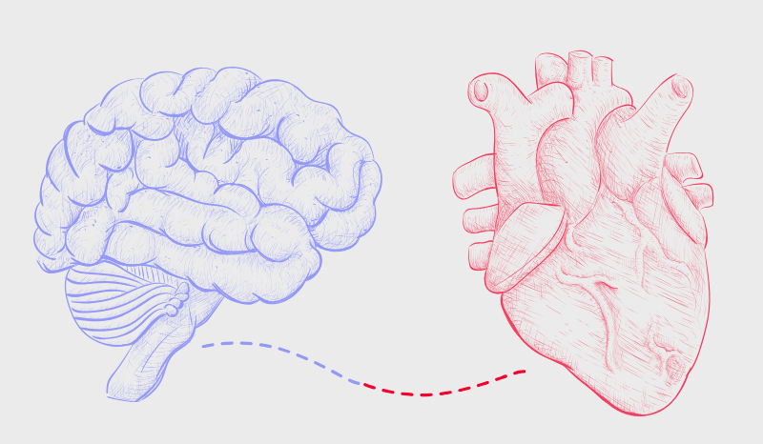



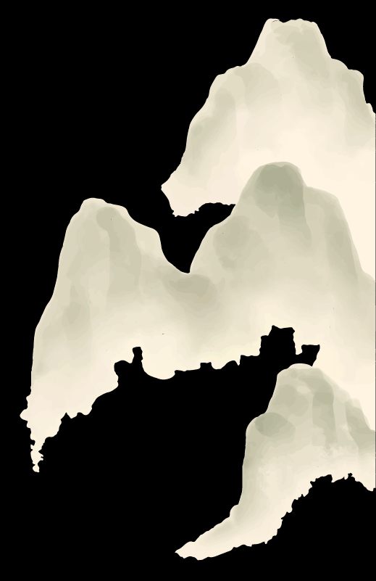


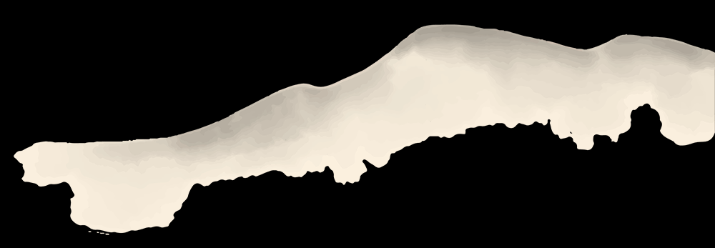
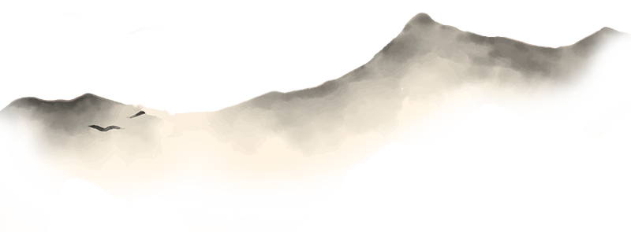
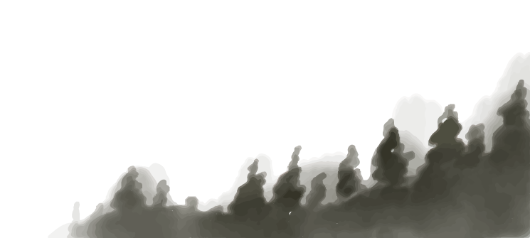
Brain Heart Models
Dr. Rahul Venugopal Cognitive Scientist Centre for Consciousness Studies

Slide 2
Outline
1
2
What are Laguerre functions and how they eliminate the frequency approach of LF and HF
Kalman Filter
3
4
What are Laguerre functions and how they eliminate the frequency approach of LF and HF
Kalman Filter

Slide 3
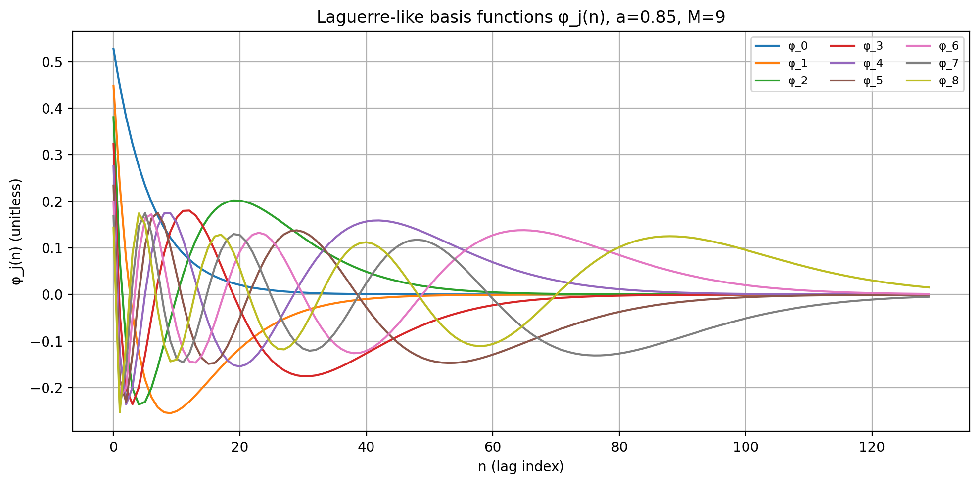
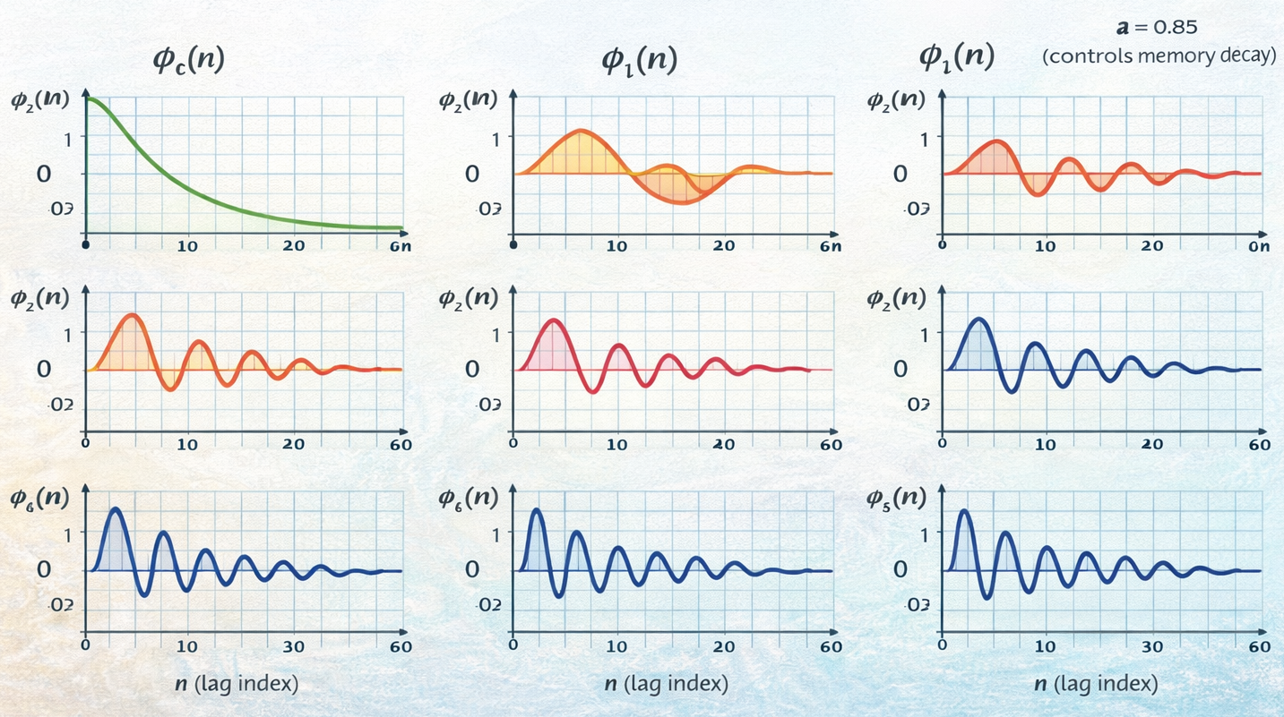
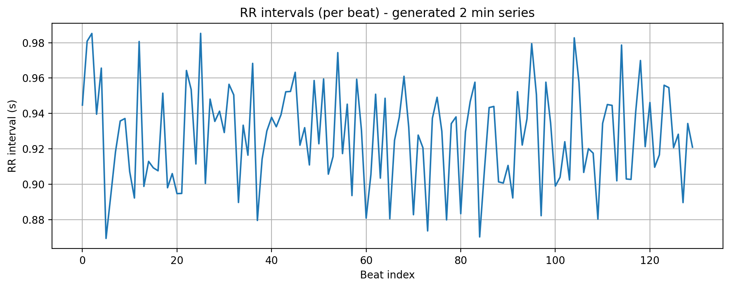
Laguerre Functions
Notes:
each Laguerre function corresponds to a family of frequencies weighted over time.
Low-order Laguerre → low-pass, tonic behavior
Very high order → increasingly oscillatory but still causal and decaying
Laguerre expansions encode temporal structure, not explicit frequency bins.
“How does the recent past over multiple time scales influence the present?”
a≈0: very short memory
$a≈1$: very long memory
memory length≈1/1-a
M=1: single low-pass memory
$M=3$: baseline + trend + curvature
$M=9$: multiple oscillatory memory channels (typical in autonomic modeling)
​

Slide 4
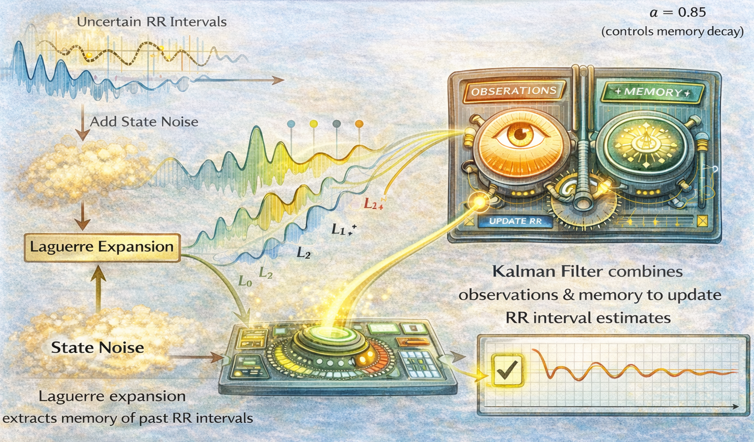

Slide 5
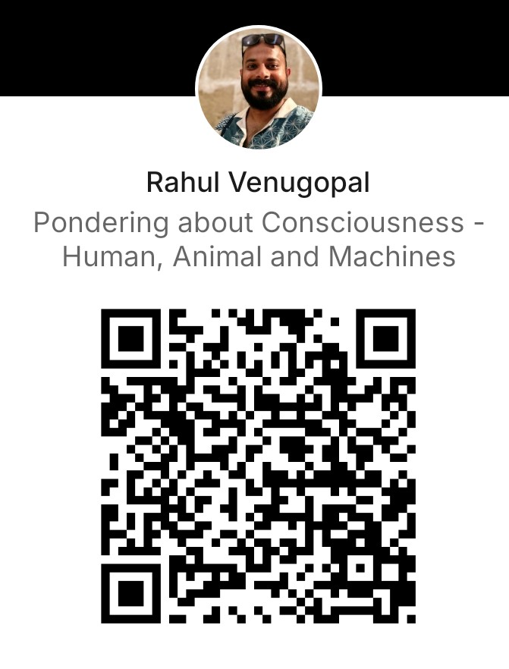
Thank you
rahul.nimhans@gmail.com

